Slide 1

Netflix Movies & TV Shows Data Analysis
Internship: Unified Mentor _ Data Analyst
Name: Abdullah Jaffari Syed
Tools: Python (Pandas, Matplotlib, Seaborn, WordCloud)
Dataset Size: 8,790 entries

Slide 2
Project Overview
Analyzed Netflix content library using Python
Explored Movies, TV Shows, ratings, genres, countries
Identified monthly & yearly trends
Extracted insights for content strategy

Slide 3
Project Objectives
Understand content type distribution
Analyze ratings & audience groups
Identify top contributing countries
Study seasonal release patterns
Explore dominant genres
Summarize insights & recommendations

Slide 4
Dataset Description
Total records: 8,790
Fields: Type, Title, Director, Country, Rating, Duration, Genres, Date …………Added
Data Cleaning: duplicates removed, missing values fixed,
date formats standardized, year/month extracted

Slide 5
Data Cleaning Steps
Replaced missing values
Converted date formats
Extracted year/month/day
Cleaned duration column
Verified dataset consistency

Slide 6
Key Visualizations Overview
Movies vs TV Shows
Ratings Distribution
Top 10 Countries
Monthly Releases
Yearly Content Additions
Genre Frequency
Word Cloud

Slide 7
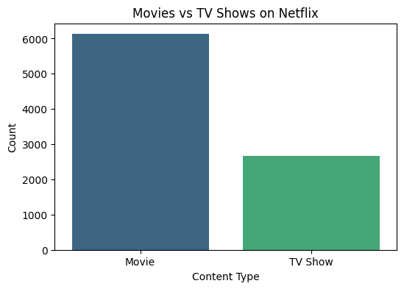
Movies vs TV Shows

Slide 8
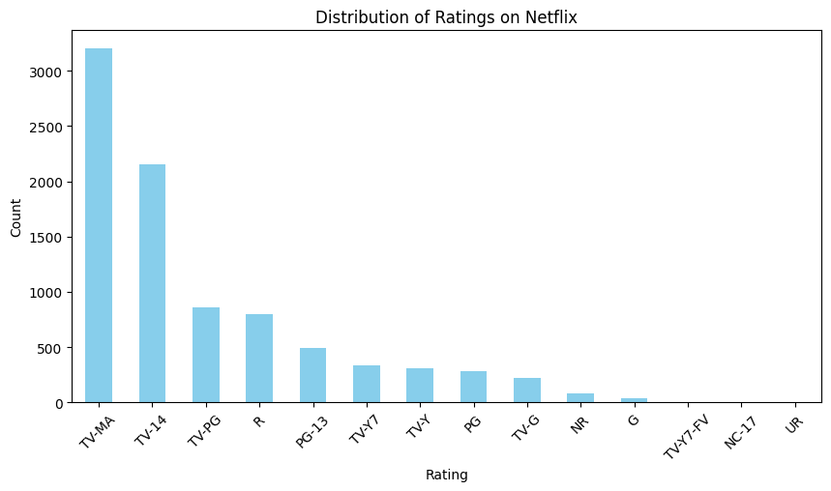
Ratings Distribution

Slide 9
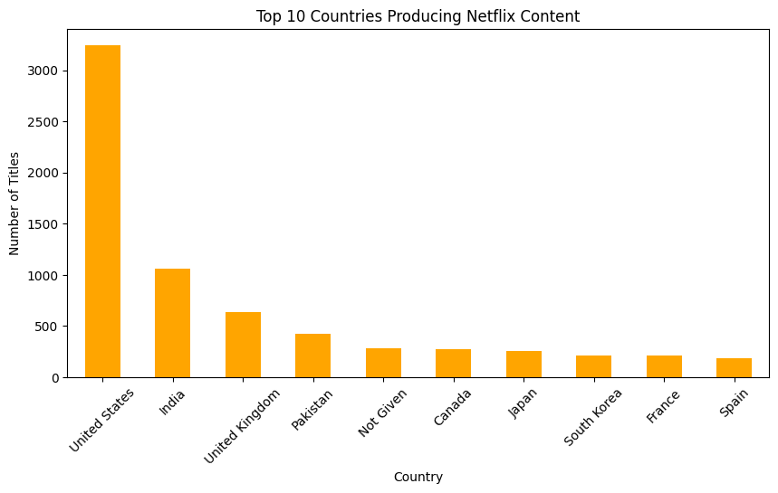
Top 10 Countries

Slide 10
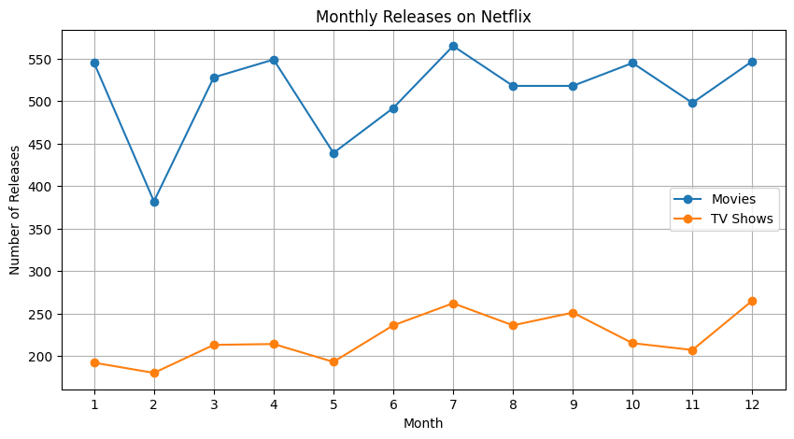
Monthly Releases

Slide 11
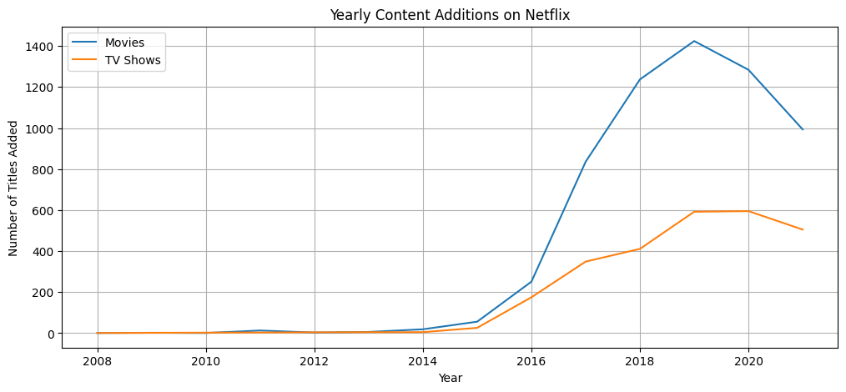
Yearly Content Additions

Slide 12
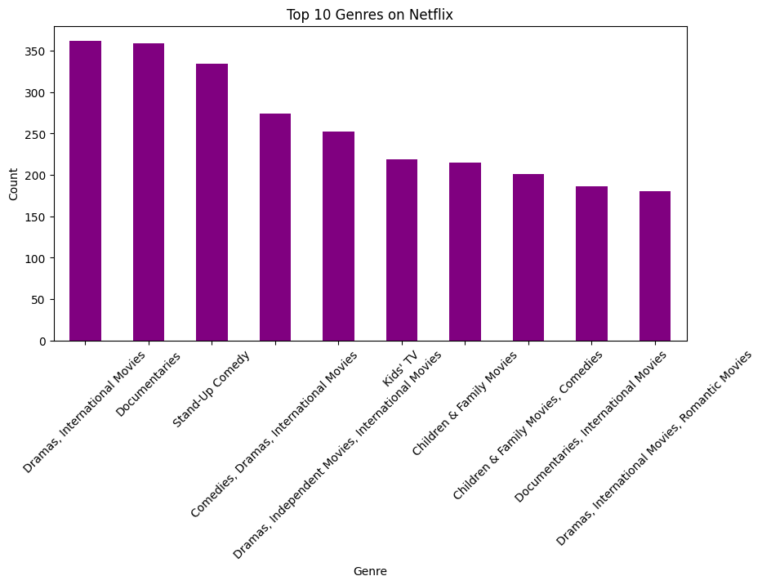
Top Genres

Slide 13
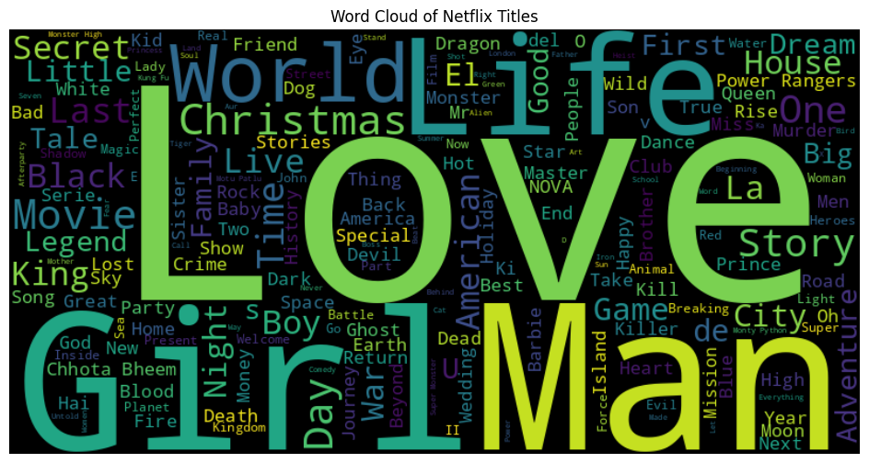
Word Cloud of Titles

Slide 14
Major Insights
Netflix has more movies than TV shows
TV-MA dominates ratings
USA & India lead content production
Strong growth after 2017
Most releases between Aug–Dec
Drama & International genres dominate

Slide 15
Business Recommendations
Increase family-friendly content
Invest in regional originals (India, Korea)
Strengthen drama & international genres
Release more content in peak months

Slide 16
Conclusion
Netflix focuses on movies & adult-rated content
Content expansion accelerated after 2017
Genres show strong audience demand
Insights support future content decisions

Slide 17
Thank You
Open to questions & improvements
Email: owaisjaffari2005@gmail.com

